Slide 1



Intro To Object Oriented Programming A new “programming paradigm”
XOLA DOS SANTOS

Slide 2

“
Think twice, code once.
Xola dos Santos

Slide 3
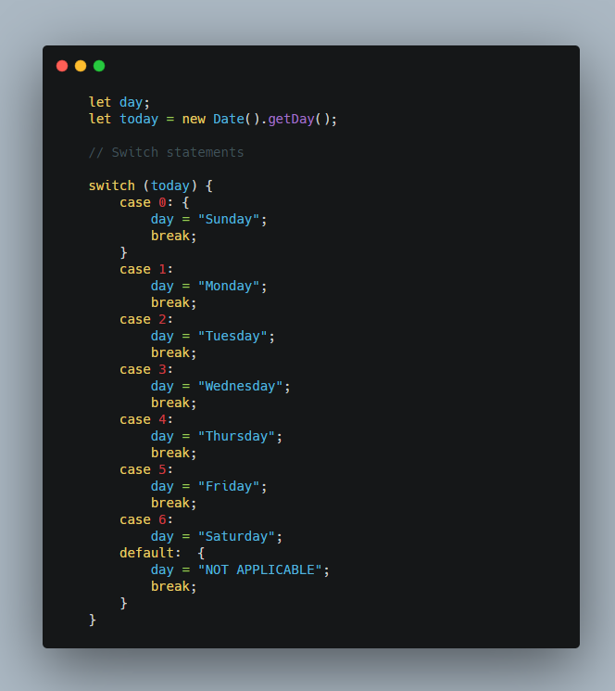
Conditional Operators:
- is equal to ==
- is not equal to !=
- is (strict) equal to === ( checks data type and value )
- is (strict) not equal to !==
- is greater than >
- is less than sign <
Logical Operators:
- Logical AND : &&
- Logical OR : ||
- Logical NOT : !
Switch Statements

Slide 4

RECAP
What we covered last week
Loops
Functions

Slide 5

Objects & Arrays
Arrays Intro
Data Types
Objects Intro
Array Methods & Properties
Arrays in Dept

Slide 6


Slide 7
OOP & Software Maintenance
Fundamental Object Oriented Programming
Variable Scope & Data Encapsulation
Understanding Classes
Object Privacy with Object Accessors
Understanding this

Slide 8


Slide 9

Challenges
Exercises for next week
Frontend Validation Challenges 1-3

Slide 10


Slide 11

CONTACT
www.codespace.co.za
@codespace_academy
emma@codespace.co.za

